Slide 1
Generating Implementations of Data Type Operations
Anthony Hunt and Emil Sekerinski
McMaster University, Hamilton, Canada
Notes:
Thank you for the introduction
Thanks for having me here today
Joint work with my supervisor, professor emil sekerinski
Talking about abstract data type operations
Two Questions:
How are abstract data types used (in formal specification)?
How can we make their use more efficient for execution in programming languages
Intersection between formal specification languages and programming languages
Focus on collection types like sets, sequences, and relations
Overview:
Abstract Data Types
Motivating Examples
Goals
Related Work
A Term Rewriting Optimizing Compiler
Example Implementations with TRS
Results
Future Work

Slide 2
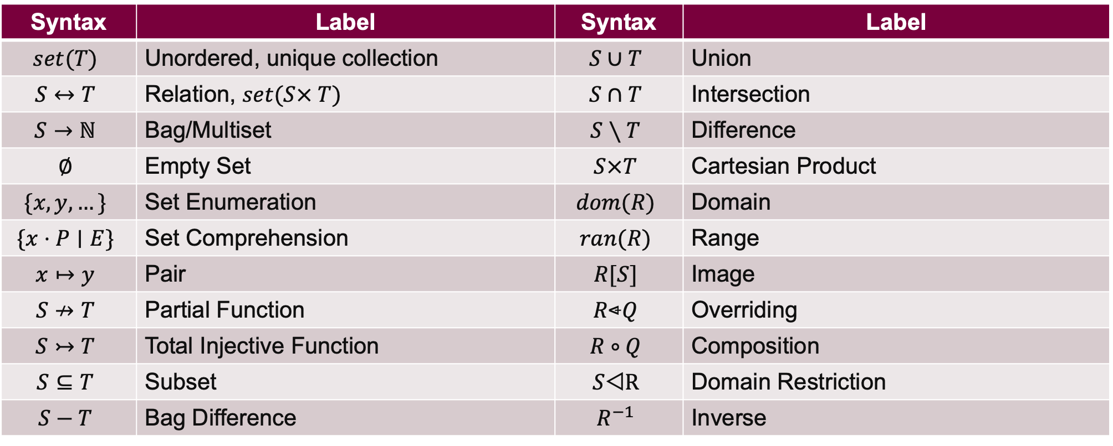
Abstract Data Types
Operations [Abrial 10][Gries, Schneider 93]
Syntax | Label | Syntax | Label
$$set(T)$$ | Unordered, unique collection | $$S∪T$$ | Union
$$S↔T$$ | Relation, $set(S× T)$ | $$S∩T$$ | Intersection
$$S→ℕ$$ | Bag/Multiset | $$S∖T$$ | Difference
$$∅$$ | Empty Set | $$S×T$$ | Cartesian Product
$$\{x, y, …\}$$ | Set Enumeration | $$dom(R)$$ | Domain
$$\{x⋅P∣E\}$$ | Set Comprehension | $$ran(R)$$ | Range
$$x↦y$$ | Pair | $$R[S]$$ | Image
$$S↛T$$ | Partial Function | $$R\text{}Q$$ | Overriding
$$S↣T$$ | Total Injective Function | $$R∘Q$$ | Composition
$$S⊆T$$ | Subset | $$S\text{◁}\text{R}$$ | Domain Restriction
$$S−T$$ | Bag Difference | $$R^{−1}$$ | Inverse
Notes:
What kinds of abstract data types are we optimizing?
Specification languages focus on generic collection types: sets and relations
Conventional operations like union, intersection, cardinality are extremely common when interacting with these abstract types
Both in formal methods and in programming
Notation of some operations here follows Event-B (Pair, Overriding, Domain restriction), but are consistent with general discrete math
To give you a better idea of how we use these operators in system specification, lets look at a few examples

Slide 3
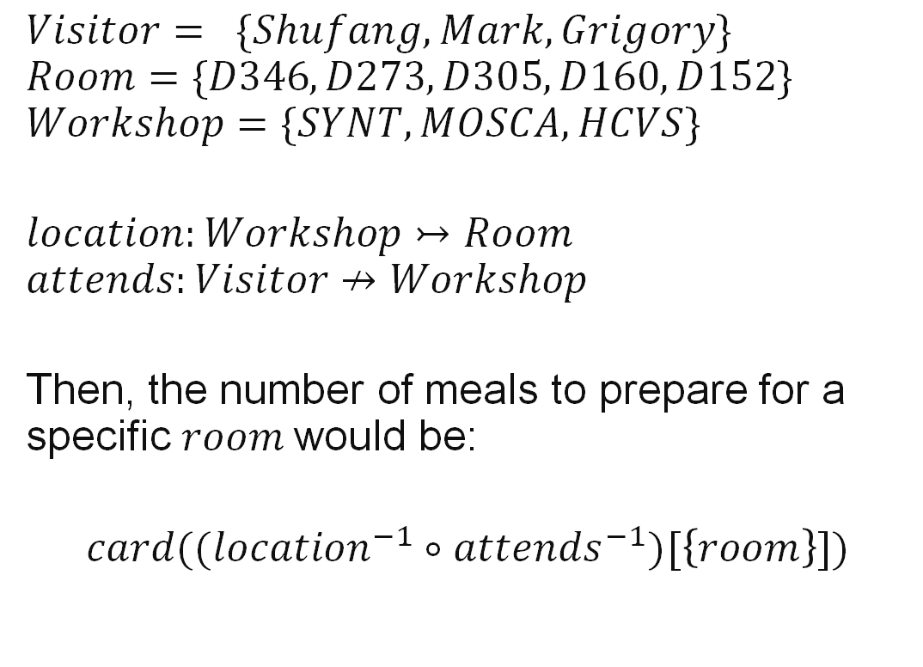
Visitor Information System
Motivating Examples
$$Visitor= \{Shufang, Mark,Grigory\}$$
$$Room=\{D346, D273, D305, D160, D152\}$$
$$Workshop=\{SYNT, MOSCA, HCVS\}$$
$$location:Workshop↣Room$$
$$attends:Visitor↛Workshop$$
Then, the number of meals to prepare for a specific $room$would be:
$$card((location^{−1}∘attends^{−1})[\left\{room\right\}])$$
Academics attend workshops throughout CAV 2025
Every workshop must be held in one room
Visitors may attend at most one workshop at a time
Total Injective Function
Partial Function
Relational Image
Notes:
Let’s say we are an administrator for a conference like CAV
We need a system to register attendees and allocate resources
Few rules to follow
Academics can attend several workshops
Every workshop must be held in one room
Visitors may attend at most one workshop at a time
Ex. “Mark” attends the “SYNT 2025” workshop
The SYNT workshop is in room D346
What if the organizers decide to prepare meals for a specific room?
How many meals would they need?
We can model this with three sets
Visitor
Room
Workshop
Two relations
Location (a one-to-one functional relation)
Attends (partial function)

Slide 4
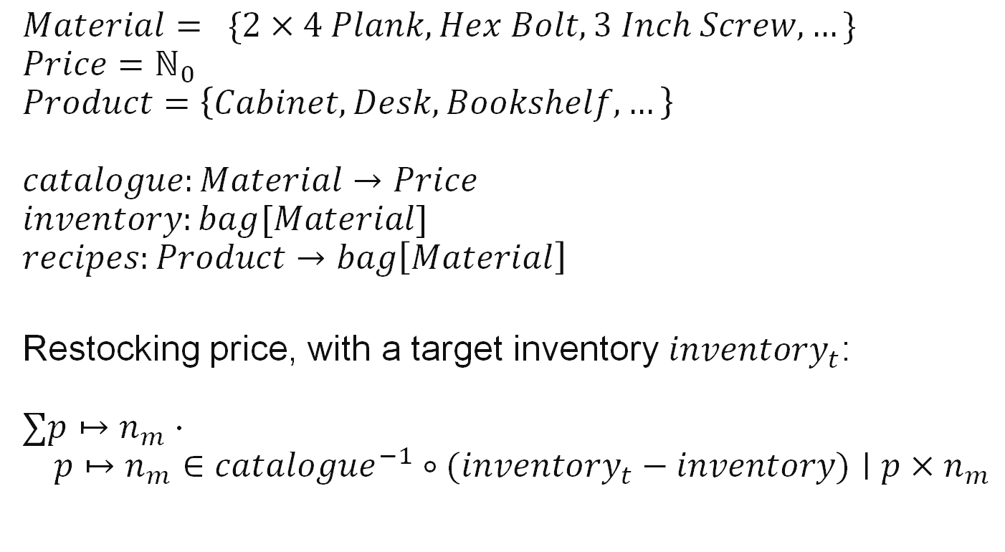
Warehouse Inventory System
Motivating Examples
$$Material= \{2×4 Plank, Hex Bolt, 3 Inch Screw,…\}$$
$$Price=ℕ_{0}$$
$$Product=\left\{Cabinet, Desk, Bookshelf, …\right\}$$
$$catalogue:Material→Price$$
$$inventory:bag[Material]$$
$$recipes:Product→bag\left[Material\right]$$
Restocking price, with a target inventory $inventory_{t}$:
$$∑p↦n_{m}⋅ \\ p↦n_{m}∈catalogue^{−1}∘{(inventory}_{t} − inventory)∣p×n_{m}$$
Furniture material catalogue
Warehouse inventory
Product recipes
Bag Difference
Notes:
Track the flow of inventory within a build-it-yourself warehouse
3 Objects: Materials, prices, products
A catalogue that tracks the prices of various furniture materials
Warehouse inventory of materials
Recipe for creating products from some combination of materials
Bags are just relations from the domain of the underlying items to the natural numbers, counting the number of occurrences
Want to know:
Price of restocking the warehouse with a target inventory

Slide 5


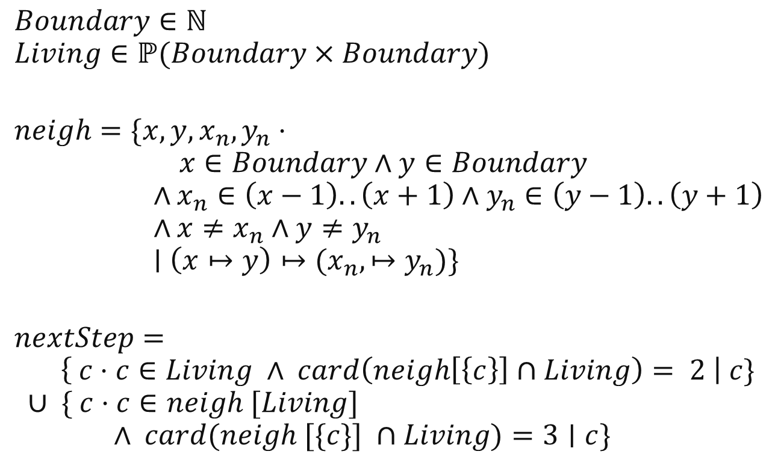
Conway’s Game of Life
Motivating Examples [Leuschel 20]
$$Boundary∈ℕ$$
$$Living∈ℙ(Boundary×Boundary)$$
$$neigh=\{x,y,x_{n},y_{n}⋅ \\ x∈Boundary∧y∈Boundary \\ ∧x_{n}∈\left(x−1\right)..\left(x+1\right)∧y_{n}∈\left(y−1\right)..\left(y+1\right) \\ ∧x≠x_{n}∧y≠y_{n} \\ ∣\left(x↦y\right)↦(x_{n},↦y_{n})\}$$
$$nextStep= \\ \left\{ c⋅c∈Living ∧ card\left(neigh\left[\left\{c\right\}\right]∩Living\right)= 2 \right| c\} \\ ∪ \{ c⋅c∈neigh [Living] \\ ∧ card(neigh [\{c\}] ∩Living)=3∣c\}$$
Next state depends on previous position
Cells with 2 or 3 neighbours remain living
Dead cells with 3 living neighbours are revived
Credit (Image): Conway’s Game of Life. Wikipedia, 2025. https://en.wikipedia.org/wiki/Conway%27s_Game_of_Life
Notes:
Simple cellular automaton
Next state of the simulation depends only on the previous position
Rules:
Cells are either dead or alive
Living cells with 2 or 3 neighbours remain living, otherwise they die
Dead cells with exactly 3 living neighbours are revived
Programmer thought process:
Create grid
Mark living/dead “cells”
Update markings each turn
Specification modelling process:
Create a set of tuples
Track living cells
Update set each turn
Main difference: specification only cares about living cells (and the boundary)
$neigh$ is a relation representing all pairs of neighbours in all cells, whether living or dead
Contains a mapping from a cell to the 8 adjacent cells,
On next iteration:
Specification uses multiple calls to $neigh$
Straightforward implementation of this specification can be very inefficient!
Global neighbour set takes up a very large amount of space
Repeated calculations over the same element (Living vs neigh[Living])

Slide 6
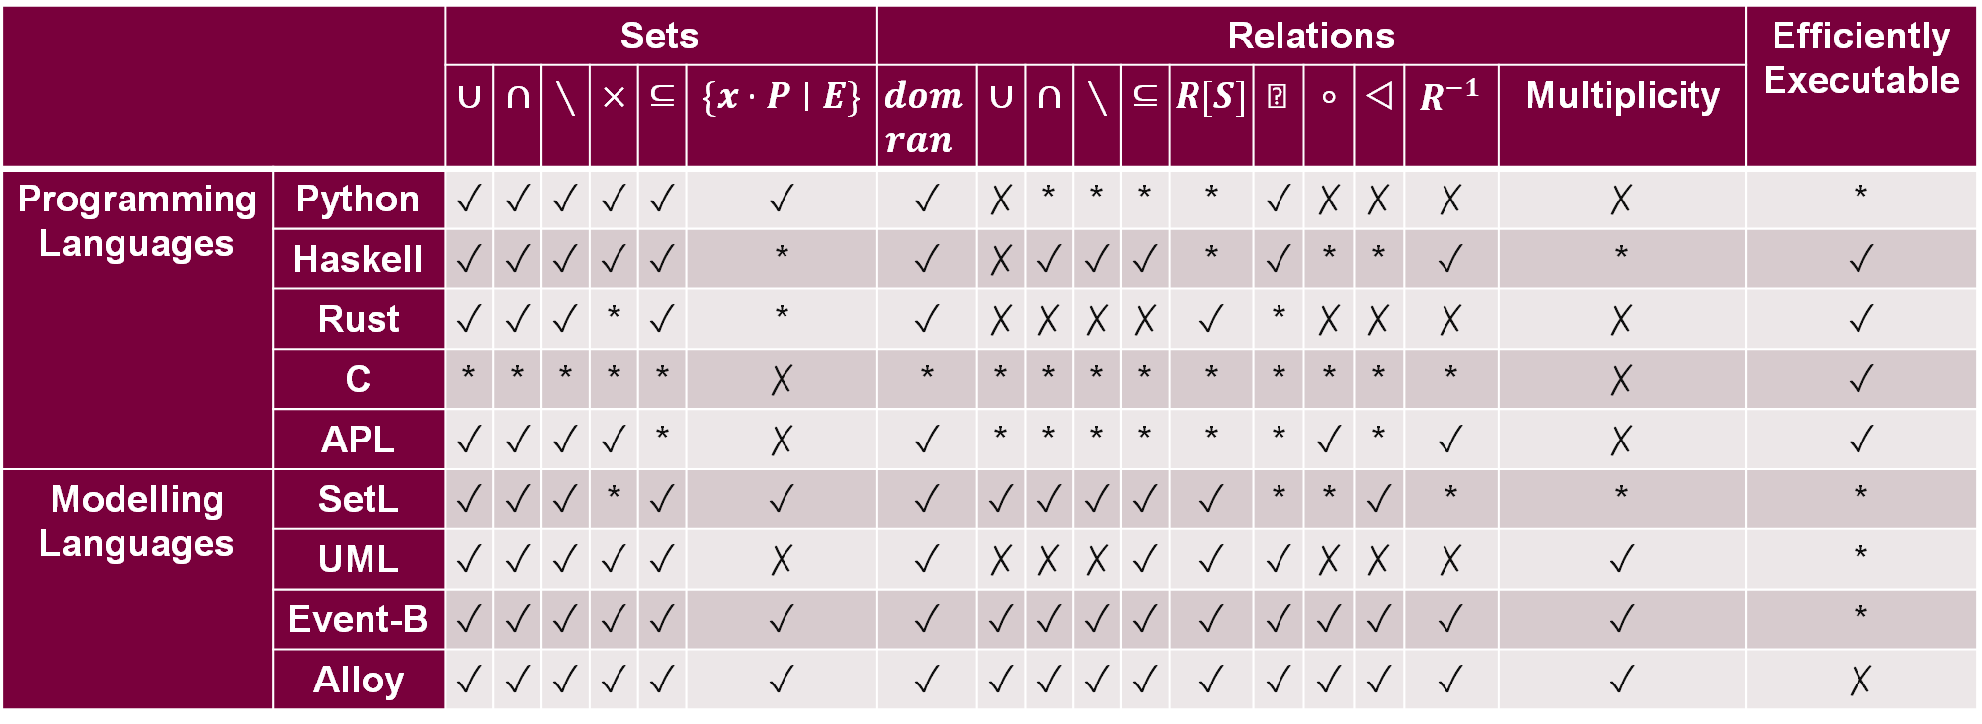
Abstract Data Types
In Programming and Modelling Languages
 |  | Sets |  |  |  |  |  | Relations |  |  |  |  |  |  |  |  |  |  | Efficiently Executable
 |  | $∪$ | $∩$ | $∖$ | $×$ | $⊆$ | $\{x⋅P∣E\}$ | $$dom$$ $ran$ | $∪$ | $∩$ | $∖$ | $⊆$ | $R[S]$ | $$\text{}$$ | $∘$ | $\text{◁}$ | $R^{−1}$ | Multiplicity
Programming Languages | Python | ✓ | ✓ | ✓ | ✓ | ✓ | ✓ | ✓ | ✗ | * | * | * | * | ✓ | ✗ | ✗ | ✗ | ✗ | *
 | Haskell | ✓ | ✓ | ✓ | ✓ | ✓ | * | ✓ | ✗ | ✓ | ✓ | ✓ | * | ✓ | * | * | ✓ | * | ✓
 | Rust | ✓ | ✓ | ✓ | * | ✓ | * | ✓ | ✗ | ✗ | ✗ | ✗ | ✓ | * | ✗ | ✗ | ✗ | ✗ | ✓
 | C | * | * | * | * | * | ✗ | * | * | * | * | * | * | * | * | * | * | ✗ | ✓
 | APL | ✓ | ✓ | ✓ | ✓ | * | ✗ | ✓ | * | * | * | * | * | * | ✓ | * | ✓ | ✗ | ✓
Modelling Languages | SetL | ✓ | ✓ | ✓ | * | ✓ | ✓ | ✓ | ✓ | ✓ | ✓ | ✓ | ✓ | * | * | ✓ | * | * | *
 | UML | ✓ | ✓ | ✓ | ✓ | ✓ | ✗ | ✓ | ✗ | ✗ | ✗ | ✓ | ✓ | ✓ | ✗ | ✗ | ✗ | ✓ | *
 | Event-B | ✓ | ✓ | ✓ | ✓ | ✓ | ✓ | ✓ | ✓ | ✓ | ✓ | ✓ | ✓ | ✓ | ✓ | ✓ | ✓ | ✓ | *
 | Alloy | ✓ | ✓ | ✓ | ✓ | ✓ | ✓ | ✓ | ✓ | ✓ | ✓ | ✓ | ✓ | ✓ | ✓ | ✓ | ✓ | ✓ | ✗
Notes:
This table shows out-of-the-box support for set and relation types
Virtually every language offers the most common set operations
Most relation operations can be implemented through basic set operations, but we are looking for dedicated support
Ex. A set of tuples doesn’t really work
Inefficient membership operations
Programming languages
Sets: hashsets or tree-based sets
Relations: one-way hashmaps
Misnomer: Can only represent functional relationships (many-to-one), since duplicate hashmap keys with different values are not supported
Multiplicity of these relations cannot be stated within the type system (e.g. restricting the domain/range, determining injectivity or surjectivity, partiality)
Low level languages are focused on performance
C doesn’t really provide the programmer with any support
External libraries pick up the slack, but most C code uses concrete types (arrays, structs)
High level languages (like python) come close to offering the desired set and relation operations
Although programming languages offer set operations, they are naively implemented
Most programming language datatypes are focused on execution, close to hardware, and aren’t very suitable for modelling/proving
Modelling languages:
Modelling languages struggle with efficient execution support
ProB does work for Event-B, but does not make use of set theory for optimizations
A subset of UML can execute, but requires the help of lower-level constructs and struggles with purely theoretical relations
SetL uses value-based semantics
Results in a lot of copying – slow in practice, resulting in poor overall execution efficiency
Event-B or Alloy are good candidates for a language that optimizes set expressions

Slide 7
Goals
Of our set-based language
Syntax close to discrete mathematics
Simple, small, and usable
Highly performant execution
High-level set-theory optimization
Modelling Languages
Programming Languages
Notes:
We want: Expressiveness of modelling languages and efficiency of programming languages
What are we looking for in a model simulation language?
Syntax close to discrete mathematics
Event-B, Alloy, SetL
Formal methods experts can prove programs correct
Simple, small, and usable language
Model concepts on set-theory
Python-like approachability
Highly performant execution
Ideally approach C or Rust levels of optimization
MLIR, LLVM are already excellent at low-level optimizations
Allows us to focus on high level set optimizations
To do this
use the knowledge of set-theory to optimize expressions at a high level
Rewrite the Abstract Syntax Tree (AST) of a parsed language using set theory rules
Each rewrite rule can be proven correct
Optimize expressions one AST node at a time

Slide 8

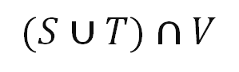
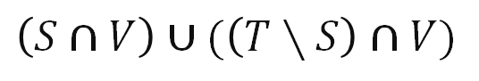
Abstract Data Types in Python
Implementation of Set Operations in Modern Languages
$$(S∪T)∩V$$
$$\left(S∩V\right)∪(\left(T∖S\right)∩V)$$
# Python translation:
ret = set()
for x in S:
ret.add(x)
# Step 1: len(ret) == len(S)
for x in T:
ret.add(x)
# Step 2: len(ret) <= len(S) + len(T)
for x in ret:
if x not in V:
ret.remove(x)
# Step 3: len(ret) <= len(V)
# New Python translation:
ret = set()
for x in S:
if x in V:
ret.add(x)
# Step 1: len(ret) <= min(len(S), len(V))
for x in T:
if x not in S and x in V:
ret.add(x)
# Step 2: len(ret) <= min(len(S) + len(T), len(V))
Notes:
One of the most popular and well-supported languages for abstract data types (sets, lists, dictionaries)
Look at example expression (S | U) & V
Python evaluates this to naïvely constructed loops of set operations
Note that the length (or cardinality) of the result set after step 3 may not depend on either S or T
Especially not the sum of S and T’s lengths, as in step 2
We also need to remove elements that have already been added to the return set
So what can we do?
In a pure set-theory world, we can rearrange the initial expression to something like:
<click>, distributing the V and eagerly restricting the size of T
Although the expression is longer, the translation is more time and memory efficient
Now, the result set never grows larger than V
The add function also does not need to implicitly check for membership inside of ret
we add the if statement “x not in S” to explicitly and eagerly check membership validity
Might unlock more optimizations later in the compilation pipeline
Limitations that prevent Python from optimizing set-oriented expressions:
Procedure side effects (e.g. printing elements in a list via a comprehension
Short circuiting behaviour
Results in larger-than-necessary intermediate set constructions

Slide 9
Related Work
ProB animation engine for Event-B [Leuschel 22]
GHC rewrite rules [Jones, Tolmach, Hoare 01]
Rewrite systems for set-theory focused optimization [Cristia, Rossi 22][Vissier, Benaissa, Tolmach 98][Smith, Westfold 20]
SETL data type lowering from abstract types to suitable concrete structures [Schonberg, Schwartz, Sharir 79][Freudenberger, Schwartz, Sharir 83]
Notes:
B or Event-B, through the ProB tool, can be used for animating specifications [Leuschel 22]
B is designed as a specification language for use with
Formal methods
Provable, Safety critical
Syntax close to discrete math
Slow execution speed
ProB is a model checker first and foremost
Used for debugging, teaching,
Not intended for deployment, but
In the 2022 LPOP workshop, Leuschel talked about increasing efficiency as an execution language
GHC uses rewrite rules to optimize Haskell functions [Jones, Tolmach, Hoare 01]
These rules could be used to express the flavour of set optimizations we are currently exploring
But extension of syntax for use with sets may be difficult
Less control over the entire compilation process
Functional style tends to focus on handling algebraic data types (eg. Linkedlist flavour of sequences)
To implement these optimizations, languages have made use of rewriting rules
Allows optimizations to be proved in bite sized steps
But these languages are focused on satisfiability, model checking, and proving rather than execution
Never in a setting intended for use as a programming language
Execution secondary to constraint solving, for example
SETL uses automatic data type lowering for sets
Bitsets for sets with a small range
Can optimize sparsely populated data structures
But only focuses on efficient representation of data and copying reduction, rather than reducing the operations themselves
Hashing (fast lookup, addition, membership) vs tree sets (log n for most ops, but keeps implicit ordering, ex. When working with integers)
We have done preliminary exploration of roaring bitsets to better accommodate larger domains
SetLog, constraint/satisfiability solver language that uses rewrite rules: https://www.clpset.unipr.it/setlog.Home.html, found in LPOP proceedings 2022 https://drive.google.com/file/d/1pS0sKhrG9HuM82JMsm5giadagjmTfNQ0/edit
Intended for proofs

Slide 10
Our Term Rewriting System
Overview: 7 Phases
Set Comprehension Construction
Predicate Disjunctive Normal Form
Nesting
Generator Selection
Code Generation 1
Equality Elimination
Code Generation 2

Slide 11
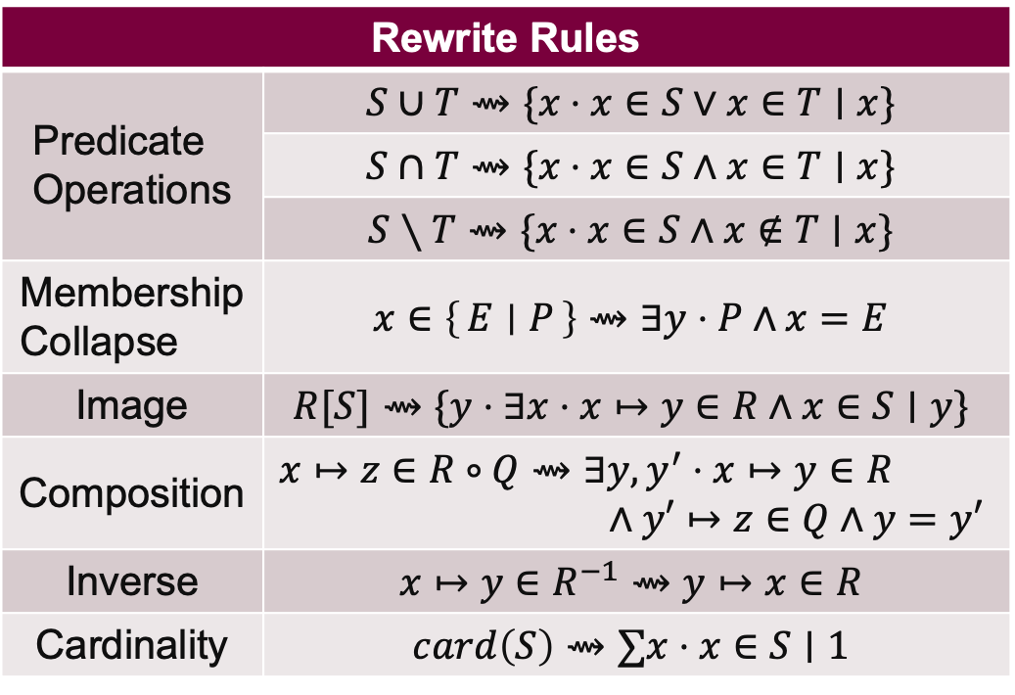
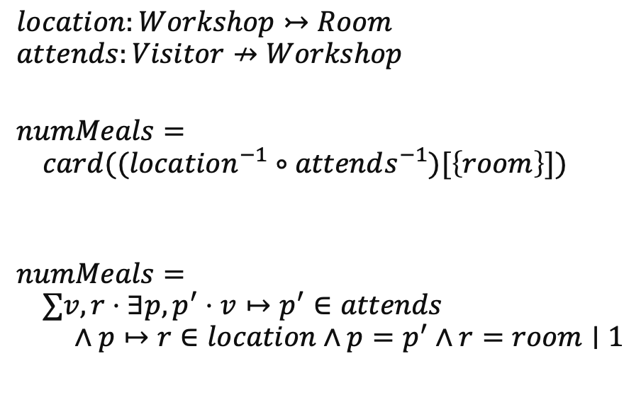
Phase 1: Set Comprehension Construction
Set-typed variables and literals are decomposed into set comprehensions
Rewrite Rules
Predicate Operations | $$S∪T⇝\{x⋅x∈S∨x∈T∣x\}$$
 | $$S∩T⇝\{x⋅x∈S∧x∈T∣x\}$$
 | $$S∖T⇝\{x⋅x∈S∧x∉T∣x\}$$
Membership Collapse | $$x∈\left\{E ∣ P\right\}⇝∃y⋅P∧x=E$$
Image | $$R[S]⇝\{y⋅∃x⋅x↦y∈R∧x∈S∣y\}$$
Composition | $$x↦z∈R∘Q⇝∃y,y^{′}⋅x↦y∈R \\ ∧y′↦z∈Q∧y=y′$$
Inverse | $$x↦y∈R^{−1}⇝y↦x∈R$$
Cardinality | $$card\left(S\right)⇝∑x⋅x∈S∣1$$
$$location:Workshop↣Room$$
$$attends:Visitor↛Workshop$$
$$numMeals= \\ card((location^{−1}∘attends^{−1})[\left\{room\right\}])$$
$$numMeals= \\ ∑v,r⋅∃p,p^{′}⋅v↦p^{′}∈attends \\ ∧p↦r∈location∧p=p^{′}∧r=room∣1$$
Post-condition:
All set-like terms must be comprehensions
Notes:
Basic set operators
Current WIP includes additional relation operators
Intuition: All set-like variables and literals are decomposed into set comprehensions
Collapse number of nested comprehensions where possible
After this phase, all set-like terms are in comprehension form
All set operators have been lowered into Boolean predicate equivalents
Example:
As we present this rewrite system, we will be applying each phase of rules in the example at the bottom right-hand corner
This is the previously seen visitor info system, where a workshop’s organizers wish to calculate the number of meals to prepare
Applying the rules:
<click>
Break down image, inverse, composition, and cardinality operators into a sum quantification with two bound variables and a large AND predicate

Slide 12
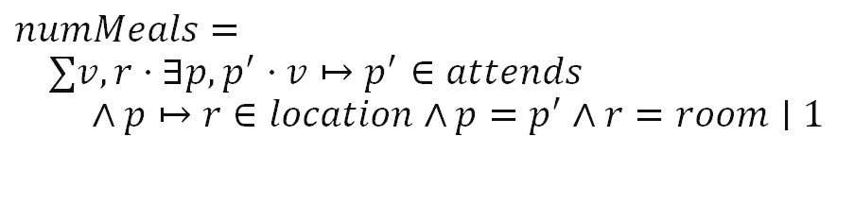
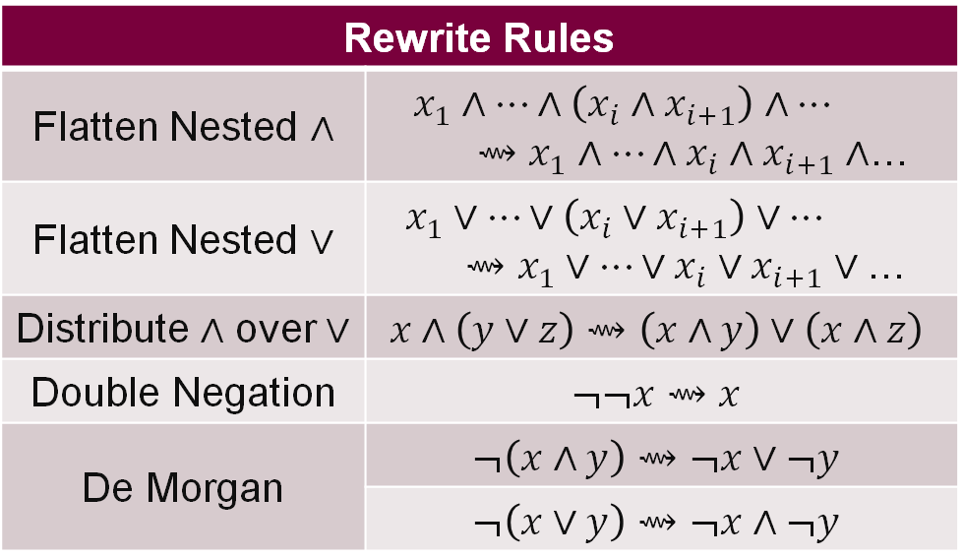
Phase 2: Predicate Disjunctive Normal Form (DNF)
Predicate structure: top-level $∨$-operations with nested $∧$-operations
Rewrite Rules
Flatten Nested $∧$ | $$x_{1}∧…∧\left(x_{i}∧x_{i+1}\right)∧…$$ $⇝x_{1}∧…∧x_{i}∧x_{i+1}∧$…
Flatten Nested $∨$ | $$x_{1}∨…∨\left(x_{i}∨x_{i+1}\right)∨…$$ $$⇝x_{1}∨…∨x_{i}∨x_{i+1}∨\text{…}$$
Distribute $∧$ over $∨$ | $$x∧\left(y∨z\right)⇝\left(x∧y\right)∨\left(x∧z\right)$$
Double Negation | $$¬¬x⇝x$$
De Morgan | $$¬\left(x∧y\right)⇝¬x∨¬y$$
 | $$¬\left(x∨y\right)⇝¬x∧¬y$$
Post-condition:
All set-like terms must be comprehensions
Quantifier predicates are in DNF
$$numMeals= \\ ∑v,r⋅∃p,p^{′}⋅v↦p^{′}∈attends \\ ∧p↦r∈location∧p=p^{′}∧r=room∣1$$
Notes:
Beginning of predicate optimization (all matches of this phase occur inside a predicate)
Put predicates of comprehensions in disjunctive normal form
DNF may cause an exponential growth in terms, but in the examples we are targeting this is not a real problem and simplifies the lowering process immensely
Afterwards, predicates are closer to a top-level OR, single-nested AND structure
Since the example contains no OR operations or negations, the statement is unchanged

Slide 13
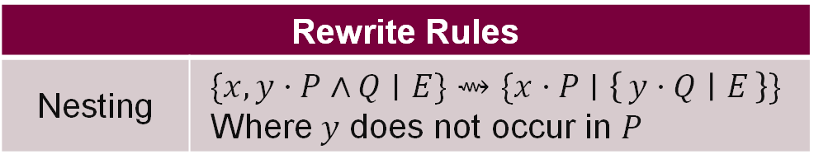
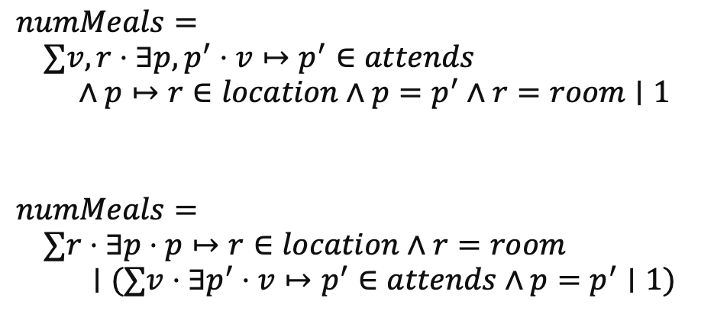
Phase 3: Nesting
Restructuring quantifications to better suit code generation
Rewrite Rules
Nesting | $$\{x,y⋅P∧Q∣E\}⇝\{x⋅P∣\left\{y⋅Q ∣ E\right\}\}$$ Where $y$ does not occur in $P$
Nesting selection is currently arbitrary; in the future we plan to use better selection heuristics
$$numMeals= \\ ∑v,r⋅∃p,p^{′}⋅v↦p^{′}∈attends \\ ∧p↦r∈location∧p=p^{′}∧r=room∣1$$
$$numMeals= \\ ∑r⋅∃p⋅p↦r∈location∧r=room \\ ∣(∑v⋅∃p^{′}⋅v↦p^{′}∈attends∧p=p^{′}∣1)$$
Post-condition:
All set-like terms must be comprehensions
Quantifier predicates are in DNF
One bound variable per quantifier
Notes:
Intuition: Restructuring quantifications to better suit code generation (ex. Some comprehensions require nested loops to generate all elements).
Double bound variables in quantifiers implies nested for loops, we isolate those here
Afterwards, predicates are guaranteed to have singly-bound quantifiers
Example:
<click>
Each sum quantifier is now separated into nested quantifications
In this case, we chose location to remain on the outside, although choosing attends would be just as usable

Slide 14
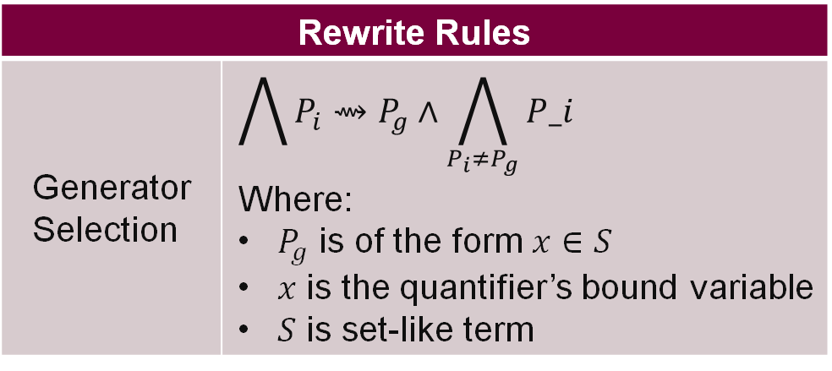
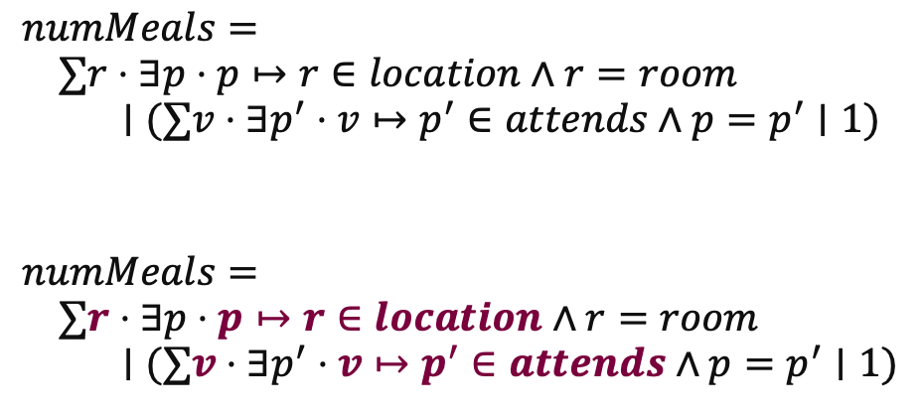
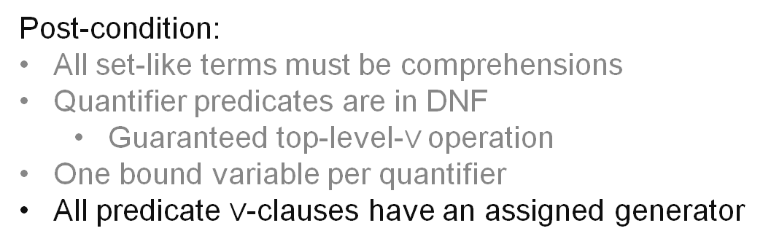
Phase 4: Generator Selection
Selecting element generators for use as iterables in generated for-loops
Rewrite Rules
Generator Selection | $$\bigwedge{P_{i}}⇝P_{g}∧\bigwedge_{P_{i}≠P_{g}}{P_i}$$ Where: $P_{g}$ is of the form $x∈S$ $x$ is the quantifier’s bound variable $S$ is set-like term
In the case of multiple candidate generators, selection is arbitrary
Generator Selection is only valid inside a quantifier’s predicate
$$numMeals= \\ ∑r⋅∃p⋅p↦r∈location∧r=room \\ ∣(∑v⋅∃p^{′}⋅v↦p^{′}∈attends∧p=p^{′}∣1)$$
$$numMeals= \\ ∑r⋅∃p⋅p↦r∈location∧r=room \\ ∣(∑v⋅∃p^{′}⋅v↦p^{′}∈attends∧p=p^{′}∣1)$$
Post-condition:
All set-like terms must be comprehensions
Quantifier predicates are in DNF
Guaranteed top-level-$∨$ operation
One bound variable per quantifier
All predicate $∨$-clauses have an assigned generator
Notes:
We know that these quantifiers must eventually be lowered into for loops
But we must choose the correct iterable (of form x in set)
For now any iterable is sufficient, although further work is planned in static analysis to choose the shortest possible iterable
Adding the condition that generators have been identified for each or-clause in the DNF predicates
Example:
<click>
The generators and bound generator variable is now bold

Slide 15
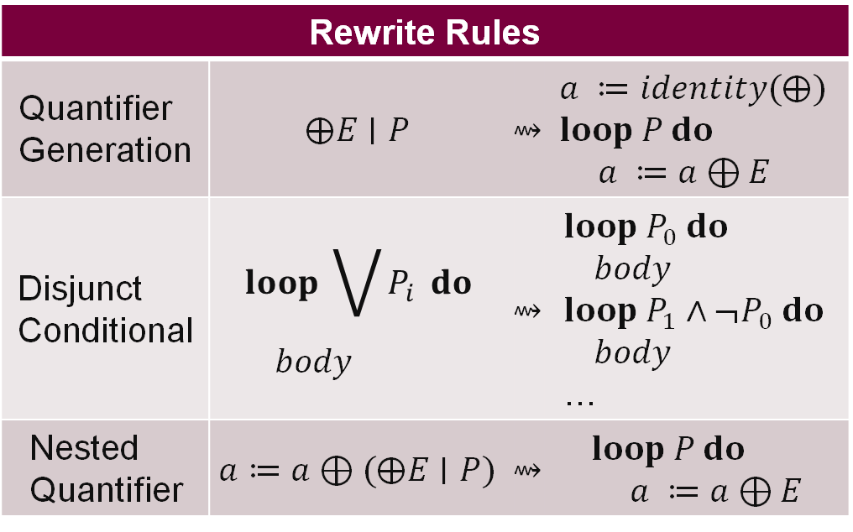
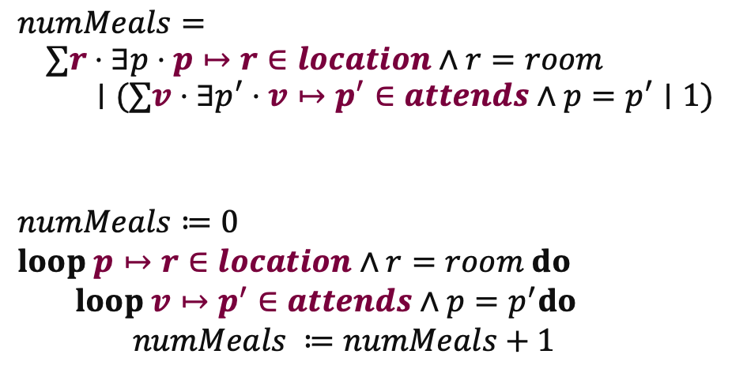
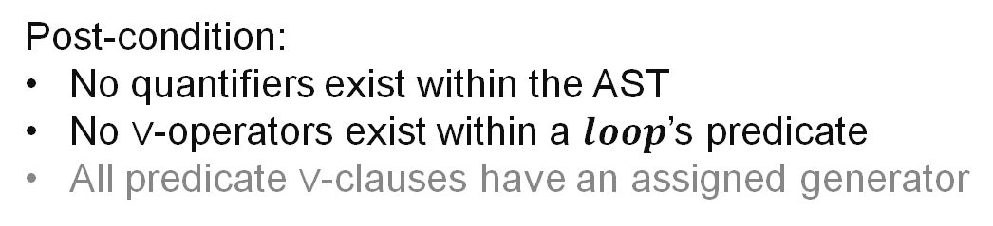

Phase 5: Code Generation 1
Start lowering expressions into imperative-like loops
Rewrite Rules
Quantifier Generation | $$⨁E∣P$$ | $$⇝$$ | $$a ≔identity(⨁)$$ $$loop P do$$ $a ≔a⊕E$
Disjunct Conditional | $$loop \bigvee{P_{i}} do$$ $$body$$ | $$⇝$$ | $$loop P_{0} do$$ $$body$$ $$loop P_{1}∧¬P_{0} do$$ $$body$$ …
Nested Quantifier | $$a≔a⊕(⨁E∣P)$$ | $$⇝$$ | $$loop P do$$ $a ≔a⊕E$
$⊕$ is any of $\left\{…\right\}, Σ, Π, ∪, ∩$
$$numMeals= \\ ∑r⋅∃p⋅p↦r∈location∧r=room \\ ∣(∑v⋅∃p^{′}⋅v↦p^{′}∈attends∧p=p^{′}∣1)$$
$$numMeals≔0 \\ loop p↦r∈location∧r=room do \\ loop v↦p^{′}∈attends∧p=p^{′}do \\ numMeals ≔numMeals+1$$
Post-condition:
No quantifiers exist within the AST
No $∨$-operators exist within a $loop$’s predicate
All predicate $∨$-clauses have an assigned generator
Notes:
Start code generation,
Quantifiers are lowered into loops (nested if need-be)
splitting OR-clause predicates into sequential loop additions
Think of how unions are actually executed, still need that sequential pass through every relevant set
Addition of negation of previously added elements guarantees that there is no double counting
Especially useful for non-idempotent quantifiers (sum, product)
At this point in time, no quantifiers are left in the AST
They have all been lowered to loops
All loops have a single, assigned generator/iterable
Example:
<click>
Quantification is now in the Loop intermediate representation

Slide 16
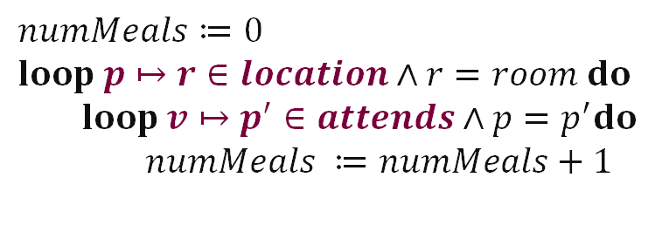
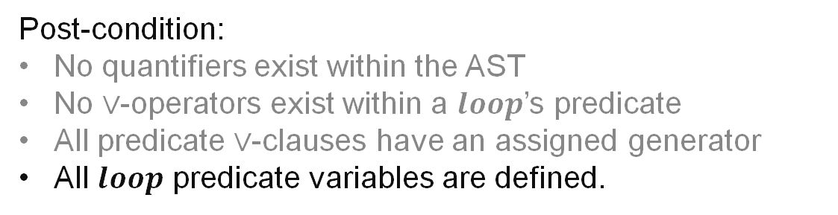
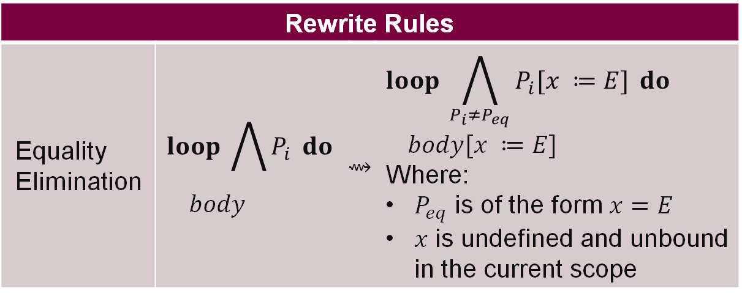
Phase 6: Equality Elimination
Eliminate all undefined variables (with implicit $∃$ quantifiers)
Rewrite Rules
Equality Elimination | $$loop \bigwedge{P_{i}} do$$ $$body$$ | $$⇝$$ | $$loop \bigwedge_{P_{i}≠P_{eq}}{P_{i}[x ≔E]} do$$ $$body[x ≔E]$$ Where: $P_{eq}$ is of the form $x=E$ $x$ is undefined and unbound in the current scope
Post-condition:
No quantifiers exist within the AST
No $∨$-operators exist within a $loop$’s predicate
All predicate $∨$-clauses have an assigned generator
All $loop$ predicate variables are defined.
$$numMeals≔0 \\ loop p↦r∈location∧r=room do \\ loop v↦p^{′}∈attends∧p=p^{′}do \\ numMeals ≔numMeals+1$$
Notes:
Extra phase to eliminate undefined variables (with implicit there-exists quantifiers)
Intended to deal with operators whose set builder notation introduces implicitly predicate-bound variables (relational composition)
This phase is late in the optimization pipeline since we also need to apply the equality substitutions to the expression of a loop
Prevents clashing with other “generators”
In addition to all other post-conditions, all variables should be defined at this point, whether through element generation (as we will see in a second) or through an assignment outside the scope of a particular match
No change to example since all predicates of the form x = expression have bound LHS variables (r is bound by the location generator, p and p’ are also bound by generators)

Slide 17
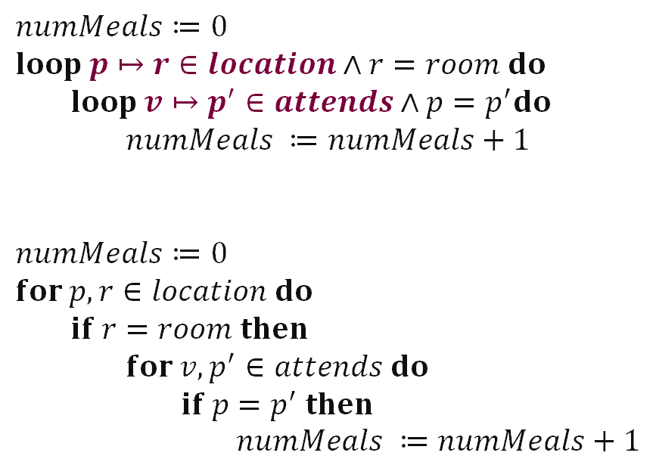
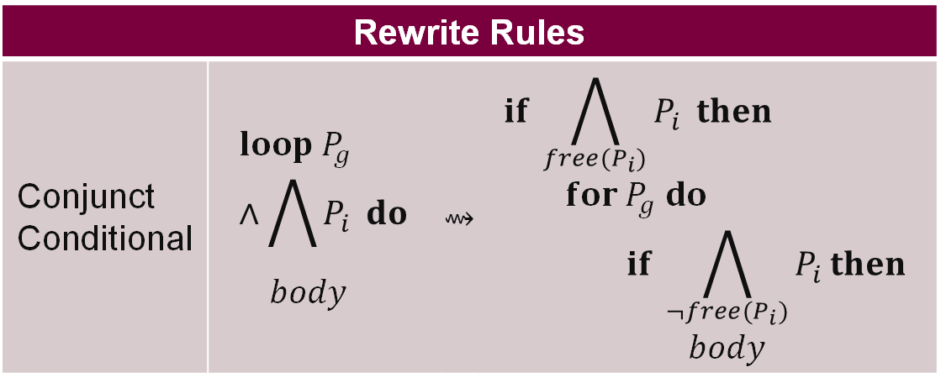
Phase 7: Code Generation 2
Eliminate all intermediate$loop$structures
Rewrite Rules
Conjunct Conditional | $$loop P_{g}∧\bigwedge{P_{i}} do$$ $$body$$ | $$⇝$$ | $$if \bigwedge_{{free(P}_{i})}{P_{i}} then$$ $$for P_{g} do$$ $$if \bigwedge_{{¬free(P}_{i})}{P_{i}}then$$ $$body$$
$$numMeals≔0 \\ loop p↦r∈location∧r=room do \\ loop v↦p^{′}∈attends∧p=p^{′}do \\ numMeals ≔numMeals+1$$
$$numMeals≔0 \\ for p,r∈location do \\ if r=room then \\ for v,p^{′}∈attends do \\ if p=p^{′} then \\ numMeals ≔numMeals+1$$
Post-condition:
Code is imperatively executable
Notes:
Final step in code generation
Lower our loop construct to a concrete for loop
Add condition checks for predicates that either need to be in or out of the loop scope
Code is executable in an imperative environment
Example:
Generators become for loops, all other predicates become if statements
We have a perfectly functional program with NO Intermediate sets!
This can still be made more efficient…

Slide 18
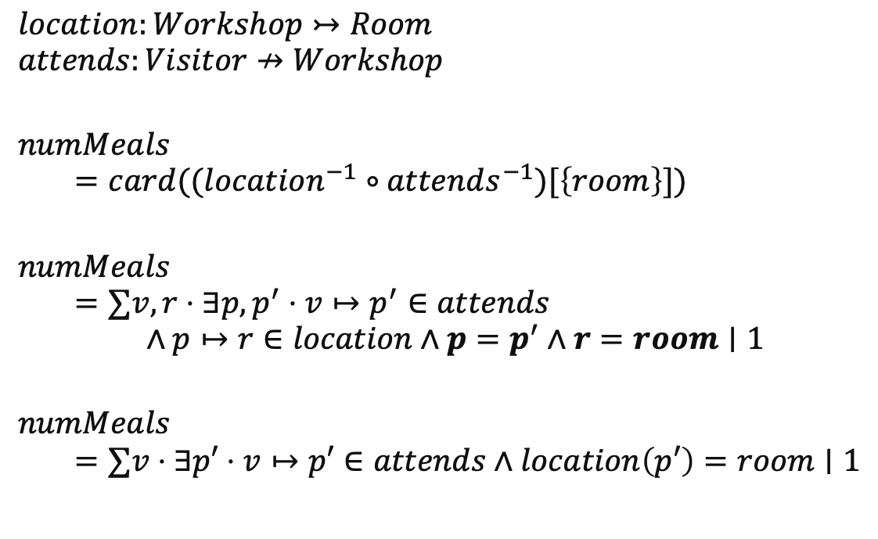
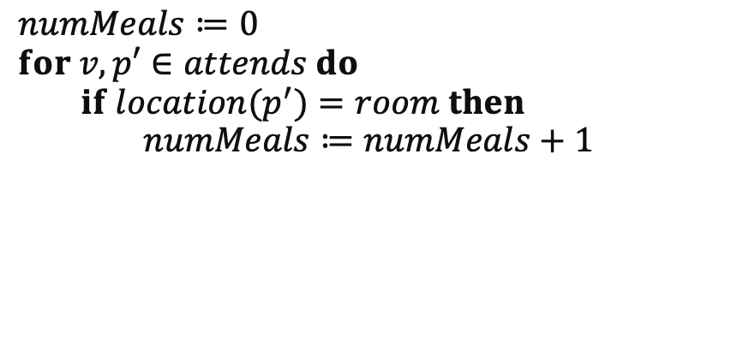
Visitor Information System - Translation
Motivating Examples
$$location:Workshop↣Room$$
$$attends:Visitor↛Workshop$$
$$numMeals$$
$$=card((location^{−1}∘attends^{−1})[\left\{room\right\}])$$
$$numMeals$$
$$=∑v,r⋅∃p,p^{′}⋅v↦p^{′}∈attends \\ ∧p↦r∈location∧p=p^{′}∧r=room∣1$$
$$numMeals$$
$$=∑v⋅∃p′⋅v↦p′∈attends∧location\left(p′\right)=room∣1$$
$$numMeals≔0 \\ for v,p′∈attends do \\ if location(p^{′})=room then \\ numMeals≔numMeals+1$$
Notes:
Backtrack to the original equation
R does not need to be iterated by this sum, since it is already restricted by an external value (the input room)
P and p’ are also equalities,
And location is a one-to-one function
so we can:
<click>
Eliminate them from the predicate
And then lower this to much more time efficient code
<click>
The transformation from set theory notation to code is only possible through manipulation of set-theory theorems
Basic requirements of these rules:
Objects and semantics must match that of set theory
No side effects
Use sets, rather than lambda calculus functions
We may need to provide the compiler with information on different kinds of relations
In this visitor information system, we could only shorten location because we knew it was a function
In this case, one-to-one and total

Slide 19
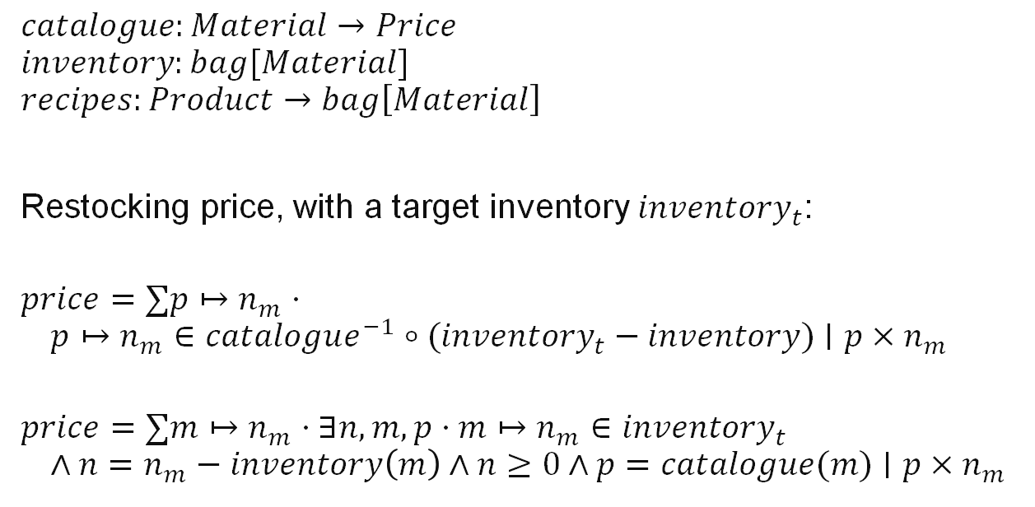
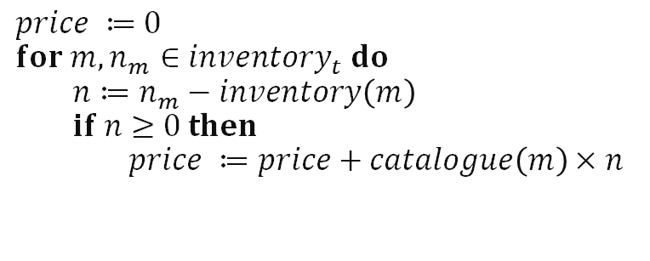
Warehouse Inventory System – Translation
Motivating Examples
$$catalogue:Material→Price$$
$$inventory:bag[Material]$$
$$recipes:Product→bag\left[Material\right]$$
Restocking price, with a target inventory $inventory_{t}$:
$$price=∑p↦n_{m}⋅ \\ p↦n_{m}∈catalogue^{−1}∘{(inventory}_{t} − inventory)∣p×n_{m}$$
$$price=∑m↦n_{m}⋅∃n,m,p⋅m↦n_{m}∈{inventory}_{t} \\ ∧n=n_{m}−inventory\left(m\right)∧n≥0∧p=catalogue(m)∣p×n_{m}$$
$$price ≔0 \\ for m,n_{m}∈inventory_{t} do \\ n≔n_{m}−inventory\left(m\right) \\ if n≥0 then \\ price ≔price+catalogue\left(m\right)×n$$
Notes:
Circling back to the warehouse inventory, let’s take another look at the restocking price sum
<click>
This composition can be rewritten in a similar way to the visitor information system
<click>
Translating this to code, we eagerly check that all conditions are met before continuing to the summation phase

Slide 20
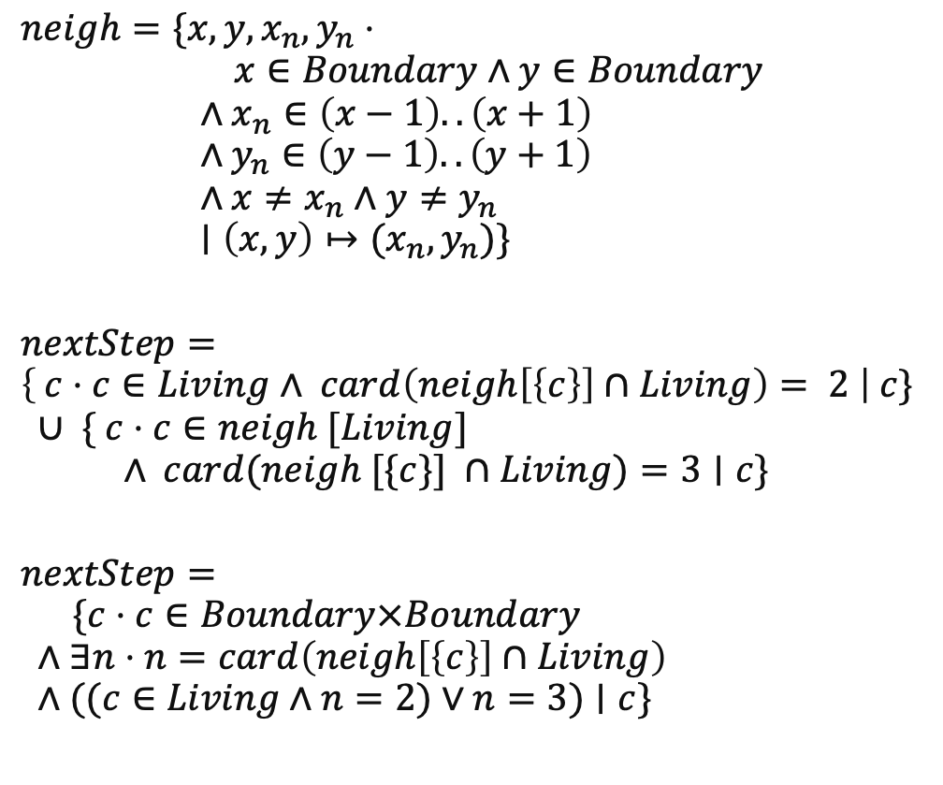
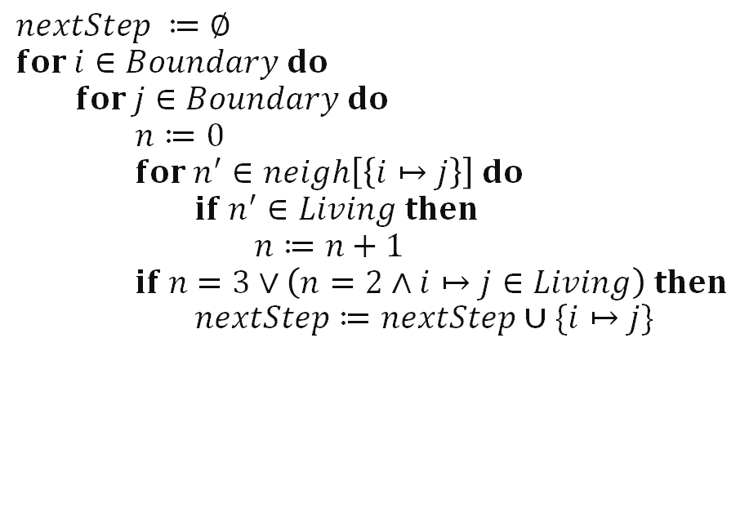
Conway’s Game of Life – Translation
Motivating Examples
$$neigh=\{x,y,x_{n},y_{n}⋅ \\ x∈Boundary∧y∈Boundary \\ ∧x_{n}∈\left(x−1\right)..\left(x+1\right) \\ ∧y_{n}∈\left(y−1\right)..\left(y+1\right) \\ ∧x≠x_{n}∧y≠y_{n} \\ ∣\left(x,y\right)↦(x_{n},y_{n})\}$$
$$nextStep= \\ \left\{ c⋅c∈Living∧ card\left(neigh\left[\left\{c\right\}\right]∩Living\right)= 2 \right| c\} \\ ∪ \{ c⋅c∈neigh [Living] \\ ∧ card(neigh [\{c\}] ∩Living)=3∣c\}$$
$$nextStep=$$
$$\{c⋅c∈Boundary×Boundary \\ ∧∃n⋅n=card\left(neigh\left[\left\{c\right\}\right]∩Living\right) \\ ∧((c∈Living∧n=2)∨n=3)∣c\}$$
$$nextStep ≔∅ \\ for i∈Boundary do \\ for j∈Boundary do \\ n≔0 \\ for n^{′}∈neigh\left[\left\{i↦j\right\}\right] do \\ if n^{′}∈Living then \\ n≔n+1 \\ if n=3∨\left(n=2∧i↦j∈Living\right) then \\ nextStep≔nextStep∪\{i↦j\}$$
Notes:
Back to conways game of life
Remember rules:
Living cell must have 2 or 3 neighbours
Dead cells with 3 living neigbours are revived
First convert into a more usable form,
<click>
then lower as usual,
<click>
Note that we do not construct the neigbour set for every cell all at once (that would take up too much space, instead calculate it on-the-fly)
Although not the most efficient implementation, this method is better than a naïve implementation with two sequential double-nested for loops (for the union operation)
No elements are removed, memory is still efficient
Future work would involve translation down to bitsets, with vectorized SIMD instructions
Locality and data parallelism are innate properties of this problem
TODO look at https://www.sciencedirect.com/science/article/pii/S187775031300094X?casa_token=o4zz1rJfHGkAAAAA:YHtwXXENah7hi1d228A8eO37rTPhK2NLtliqPgc4OCNzYYLS4U2aePC6gH4LA-fU8BV1xyhP8g

Slide 21
Preliminary Results
Intermediate sets never grow larger than max(starting sets, resulting set)
Unions, Relation Overriding, and Cartesian Products are limited in growth
Other operators only decrease the size of a resulting set
What about running time?…
Notes:
Intermediate sets never grow larger than max(starting sets, resulting set)
Unions, Relation Overriding, and Cartesian Products are limited in growth by DNF predicates
All other operators only decrease the size of a resulting set
Applied as conditions of membership at set construction time
<click>
What about running time?…

Slide 22
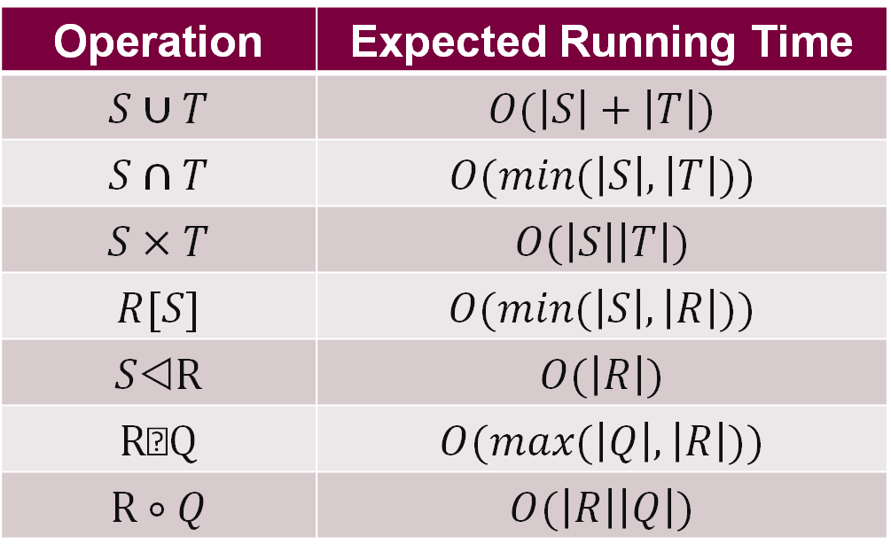
Preliminary Results
Operation Running Time
Operation | Expected Running Time
$$S∪T$$ | $$O(\left|S\right|+\left|T\right|)$$
$$S∩T$$ | $$O(min⁡(\left|S\right|,\left|T\right|))$$
$$S×T$$ | $$O(\left|S\right|\left|T\right|)$$
$$R[S]$$ | $$O(min⁡(\left|S\right|,\left|R\right|))$$
$$S\text{◁}\text{R}$$ | $$O(\left|R\right|)$$
$$\text{R}\text{}\text{Q}$$ | $$O(max⁡(\left|Q\right|,\left|R\right|))$$
$$\text{R}∘Q$$ | $$O(\left|R\right|\left|Q\right|)$$
Notes:
This is the expected worse-case running time for each of these select operators
Note the running time of comprehension – big O of R*Q

Slide 23
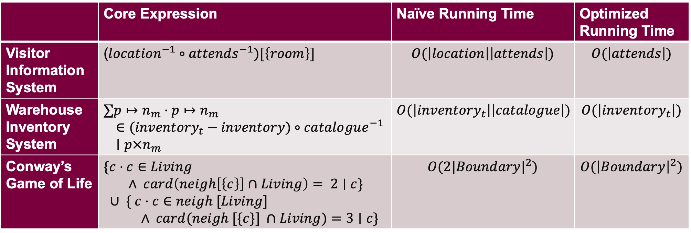

Preliminary Results
Examples Running Time
 | Core Expression | Naïve Running Time | Optimized Running Time
Visitor Information System | ($location^{−1}∘attends^{−1})[\left\{room\right\}]$ | $$O(\left|location\right|\left|attends\right|)$$ | $$O(\left|attends\right|)$$
Warehouse Inventory System | $$∑p↦n_{m}⋅p↦n_{m} \\ ∈{(inventory}_{t} − inventory)∘catalogue^{−1} \\ ∣p×n_{m}$$ | $$O(\left|inventory_{t}\right|\left|catalogue\right|)$$ | $$O(\left|inventory_{t}\right|)$$
Conway’s Game of Life | $$\{c⋅c∈Living \\ ∧ card\left(neigh\left[\left\{c\right\}\right]∩Living\right)= 2∣c\} \\ ∪ \{ c⋅c∈neigh [Living] \\ ∧ card(neigh [\{c\}] ∩Living)=3∣c\}$$ | $$O(2{|Boundary|}^{2})$$ | $$O({\left|Boundary\right|}^{2})$$
$Living∈ℙ(Boundary×Boundary)$
Notes:
In both the Visitor Information and Warehouse Inventory system, intermediate constructions of relation composition could consume O(n^2) running time.
However, knowing how the relations will be used enables us to iterate over only one of those relations
Both catalogue and location are functions, thus we know that every element in the domain can only appear once
Querying into these relations only return one value
In conways game of life, a naïve construction of the neighbour relation requires O(n^2) storage and time
Even if this relation was calculated on-the-fly as if it were a function, as in our optimized code, the running time at best would be twice as slow as ours
Ends up recalculating neigh for every living cell in the second argument of union

Slide 24
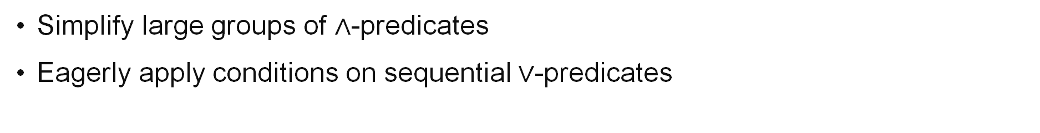
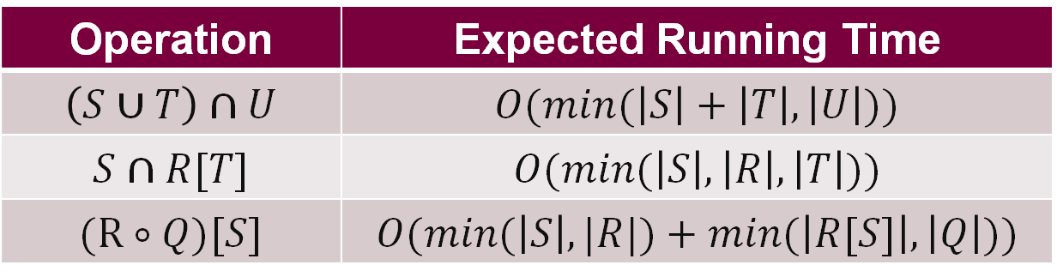
Preliminary Results
Complex Operation Running Time
Operation | Expected Running Time
$$\left(S∪T\right)∩U$$ | $$O(min⁡(\left|S\right|+\left|T\right|, \left|U\right|))$$
$$S∩R[T]$$ | $$O(min⁡(\left|S\right|,\left|R\right|,\left|T\right|))$$
$$\text{(}\text{R}∘Q)[S]$$ | $$O(min⁡(\left|S\right|, |R|)+min⁡(\left|R[S]\right|, \left|Q\right|))$$
Simplify large groups of $∧$-predicates
Eagerly apply conditions on sequential $∨$-predicates
Notes:
We can effectively lower the running time of those previous operators if we spot convenient context that limits the need for full loop iterations
Relation composition may be reduced to linear running time, like we saw with the visitor information example
What do we look for?
To optimize running time:
Simplify large groups of $∧$-predicates
Catch those extra conditions early
To optimize memory usage
Eagerly apply conditions on sequential $∨$-clause predicates
These are just the general behaviour of the examples seen using these operators, more refined definitions will follow!

Slide 25
Current Compiler State and Roadmap
Development of a High-Level, Efficient, Set-Based Language
Optimizing Rewrite Rules
Jupyter Kernel Integration
Code Generation (MLIR/LLVM)
Model Simulation Specification
Concurrency Optimizations: SIMD, Data Parallelism
Notes:
Current state of compiler
a prototype of set based rewrites, working on adding full support for relational operators
Preliminary code generation to rust (to test that our rewrite rules actually compile to an imperative program
Rust
Future work
Target LLVM, likely through the MLIR ecosystem
Ensure efficient code generation that covers low-level optimizations
Supported on numerous platforms
Compare against other language implementations of select, both highly optimized for coding and idiomatic for specification writers
Integrate into jupyter for ease of use, LLVM interops with webassembly
Addition of concurrency optimizations in other work by our group, with the end goal being a high level, simple, fast language

Slide 26
References
Michael Leuschel. ProB2 Jupyter Notebooks GitLab. 2020. https://gitlab.cs.uni-duesseldorf.de/general/stups/prob2-jupyter-notebooks/-/blob/9d830112d9713d0cbc12d9d285f44ee61c827ccf/puzzles/Game_of_Life.ipynb
Jean-Raymond Abrial. Modeling in Event-B: system and software engineering. Cambridge University Press, 2010.
David Gries and Fred Schneider. A Logical Approach to Discrete Math. Springer New York, 1993.
Robert Dewar. The SetL Programming Language. Bell Laboratories, 1979.
Simon Peyton Jones, Andrew Tolmach, and Tony Hoare. Playing by the rules: rewriting as a practical optimisation technique in GHC. In: 2001 Haskell Workshop. ACM SIGPLAN. Sept. 2001.
Michael Leuschel. Programming in B: Sets and Logic all the Way Down. In: LPOP 2022.
Maximiliano Cristia and Gianfranco Rossi. {log}: Programming and Automated Proof in Set Theory. In: LPOP 2022.
Douglas R. Smith and Stephen J. Westfold. Transformations for Generating Type Refinements. In: Formal Methods. FM 2019 International Workshops. Springer International Publishing, 2020, pp. 371-387
Edmond Schonberg, Jacob T. Schwartz, and Micha Sharir. 1979. Automatic data structure selection in SETL. In Proceedings of the 6th ACM SIGACT-SIGPLAN symposium on Principles of programming languages (POPL '79). Association for Computing Machinery, New York, NY, USA, 197–210. https://doi.org/10.1145/567752.567771
Stefan M. Freudenberger, Jacob T. Schwartz, and Micha Sharir. 1983. Experience with the SETL Optimizer. ACM Trans. Program. Lang. Syst. 5, 1 (Jan. 1983), 26–45. https://doi.org/10.1145/357195.357197

